Slide 1
Intro to Programming
C/C++
Sankalp Gupta
moklaeducation@gmail.com

Slide 2
Learning Goals
Comfort with
Basics of C/C++
Basics of Computer Science
Familiarity with IDE
Visual Studio Community Edition
Thinking logically
i.e. One step at a time
And Visualizing how computer works
Independence of technology

Slide 3
Why C/C++
Foundational understanding
Understand Computer Science
Speed and control
Fastest programming language
Really small programming language
C has 32 keywords
C++ has 92 keywords as of 2023
Makes you digital native

Slide 4
When NOT C/C++?
Slower manual speed of writing code
Don’t care about speed
Don’t care about deep Computer Science
Although this may not be achievable

Slide 5
Bit : Smallest unit of memory
Bits are used for representing everything
Have 2 states : 0 and 1 , like a bulb
On : 1
Off : 0
Nibble : 4 bits
Byte : 8 bits
int (integer ) 4 bytes
char (character ) 1 byte

Slide 6
Hertz : Unit of time and speed in Computers
1 Hertz : once per second
1 unit of work per clock instruction
Modern processors
Measured in Giga hertz
High Core Counts
More instructions

Slide 7
Hello World
Let’s go ,
Program to print “Hello World”
-----
#include <iostream> using namespace std; int main()
{
cout << “Hello World”; return 0;
}

Slide 8
Print a diamond pattern
*
***
*****
***
*

Slide 9
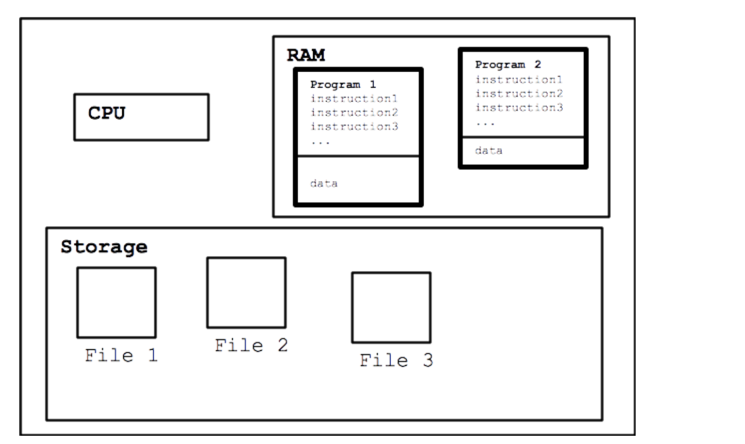
Running the program : model

Slide 10
Data Types(Primitive/built in)
bool
int
short(2), long(4)
signed,unsigned
float
float(4), double(8) , long double(8,10,16)
char(1)
signed,unsigned
wchar_t(2)
void

Slide 11
Variables
Containers for storing data
Value can change during execution (unless you don’t want it to)
Declaration
int birthyear;
float weight;
char courseGrade;

Slide 12
Data Types (Derived)
Arrays
char name[100];
Size 100
Index : 0 - 99
int age[10];
Size 10
Index : 0 - 9
float power[20]
Size 20
Index : 0 - 19

Slide 13
Integer vs floating math
Division
Float :continuos, contains decimal point
Int : discrete , truncates everything after decimal ,
float f = 10;
cout << f/3;
3.33
int i = 10;
cout<< i/3;
3

Slide 14
For reference …. | no need to | memorize
Type Name | Bytes | Other Names | Range of Values
int | 4 | signed | -2,147,483,648 to 2,147,483,647
unsigned int | 4 | unsigned | 0 to 4,294,967,295
bool | 1 | none | false or true
char | 1 | none | -128 to 127 by default
signed char | 1 | none | -128 to 127
unsigned char | 1 | none | 0 to 255
short | 2 | short int, signed short int | -32,768 to 32,767
unsigned short | 2 | unsigned short int | 0 to 65,535
long | 4 | long int, signed long int | -2,147,483,648 to 2,147,483,647
unsigned long | 4 | unsigned long int | 0 to 4,294,967,295
long long | 8 | None | -9,223,372,036,854,775,808 to 9,223,372,036,854,775,807
unsigned long long | 8 | none | 0 to 18,446,744,073,709,551,615
enum | varies | None
float | 4 | None | 3.4E +/- 38 (seven digits)
double | 8 | None | 1.7E +/- 308 (fifteen digits)
long double | 8 | None | Same as double
wchar_t | 2 |  | 0 to 65,535

Slide 15
User Defined Data Type
Enum
Short for enumeration
Define a set of named, integer constants
enum ESpeed { low, medium, high }; ESpeed fanSpeed; fanSpeed = low;

Slide 16
Code : Greeting with name/age
Given user
Store name in char array ( char name[100] )
Store year of birth in int( int birthyear)
Calculate age
age = currentYear – birthyear;
Print Name, age.
cout <<“Hello “
<< name <<“ I know your age is :“ <<age;

Slide 17
Advanced : Count digits in a number
Define a number
Return the number of digits, (assume positive)
129 → 3
34 → 2
0 → 1
Hints
You need to know loops
while
You need to know integer maths
division

Slide 18
Input , Output and Processing for Humans
Speech
Process →Speak →Listen
Book
Read →Process → Memorize
Conversation
Listen → Speak →Listen →Speak ….

Slide 19
I/O and processing for Computers
Video games
Input (controllers) →Process →Output (Screen)
Movies
Input (network) →Process → Output (visuals, audio)
Console
Input(char, int, float) → Process →Output (char(s), int, float)

Slide 20
Standard Input
cin
Read data from keyboard
Store it in variables
Extraction operator
>>
Can use multiple data types ( char, int, float , …)
Example
int age;
cin >> age;

Slide 21
Standard Output
cout
Write data to console/Screen
Reads from memory
Insertion operator
<<
Can use multiple data types(variables, literals, constants)
Example
int age = 172;
cout << age;

Slide 22
Operators >>,<<
Extraction and Insertion operators
Can be cascaded
cin >>age >> name;
cout<<age << name;
<< works with stream modifiers
“\n” : newline
cout <<“\n”; //moves the cursor to new line
Or cout <<endl; //Same visual effect as “\n” but is different
(there are other stream modifiers too)

Slide 23
Lab
Using Cin ( Hint: define a variable first)
Input a character (char)
Input an integer(int)
Input a decimal( float)
Using cout
Output a character
Output an integer
Output a decimal.
Use endl and “\n”
Cascade the operators

Slide 24
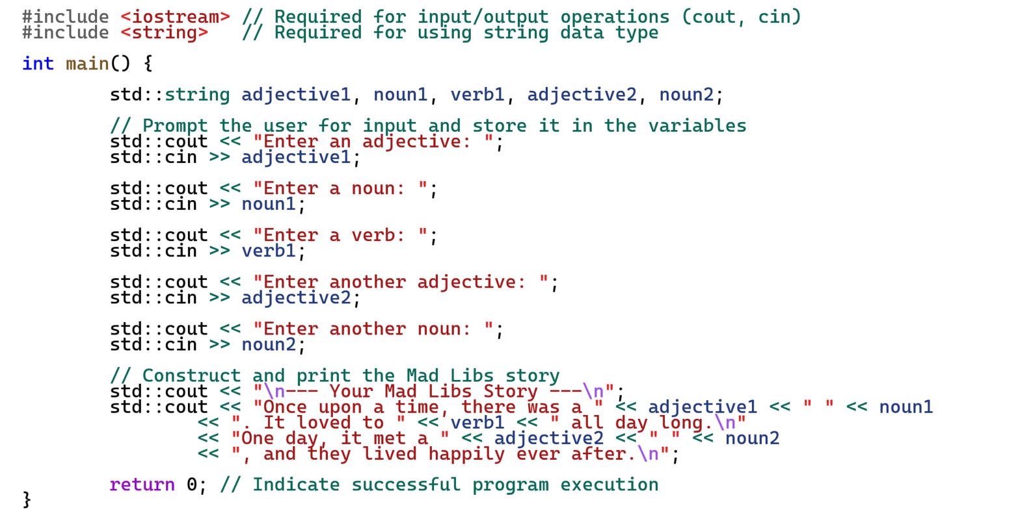
Assignment : Mad libs story

Slide 25
Boss Assignment
Input student details
Student Name
Subject name
Marks ( out of 100)
Process
Find grade using this table
90 <marks →A
75 <= marks < 90 →B
60 <= marks <=74 →C
marks <60 →D
Output
Grade for the student
Challenge
Enter multiple students, print how many students had A, B , C and D grades each.
Hint
Need to know conditional (if-else)
May need to know loop (while)

Slide 26
Recall , Review
C/C++Keywords we know already
And few more
signed , unsigned
short , long
Computers think in 0s and 1s
What types ?
Computer have speed measured in hertz (Hz)
How much faster is 1Kilo Hertz than 1Hz ?
What are current computer speeds ?

Slide 27
Measuring computer capabilities (some more units)
FLOPS : floating point operations per second
FP 16, FP 32, FP 64
IOPS : Input/Output operations per second
Fun facts
Computers are afraid of floats
Computers are afraid of division

Slide 28
Computer trends
Getting smaller
Die sizes have been shrinking
Getting faster
Same size die have more transistors
Getting crowded
More core counts per die
Getting chatty
Networked , internet connected
Getting efficient
More performance per unit of power

Slide 29
Back to C++, Decision Making & Branching
if , else
switch
goto

Slide 30
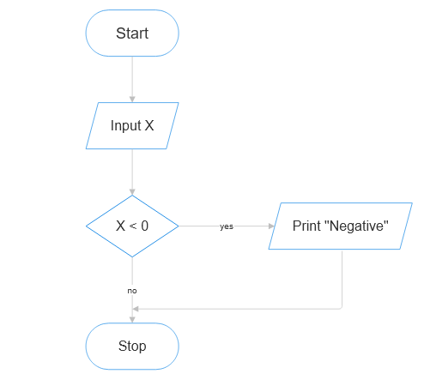
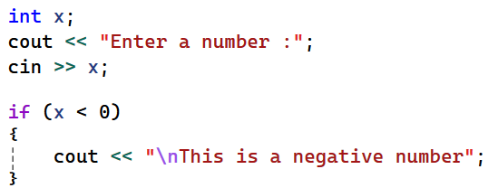
Making Decisions , using “if”

Slide 31
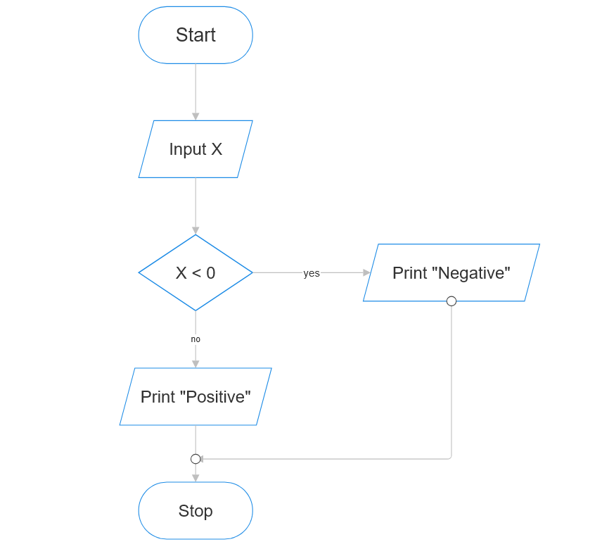
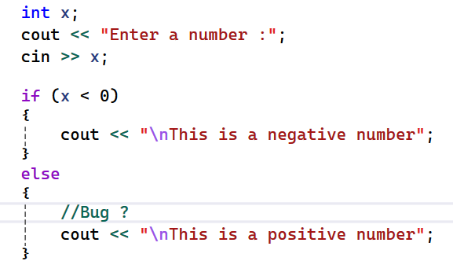
Making Decisions using “if else”

Slide 32
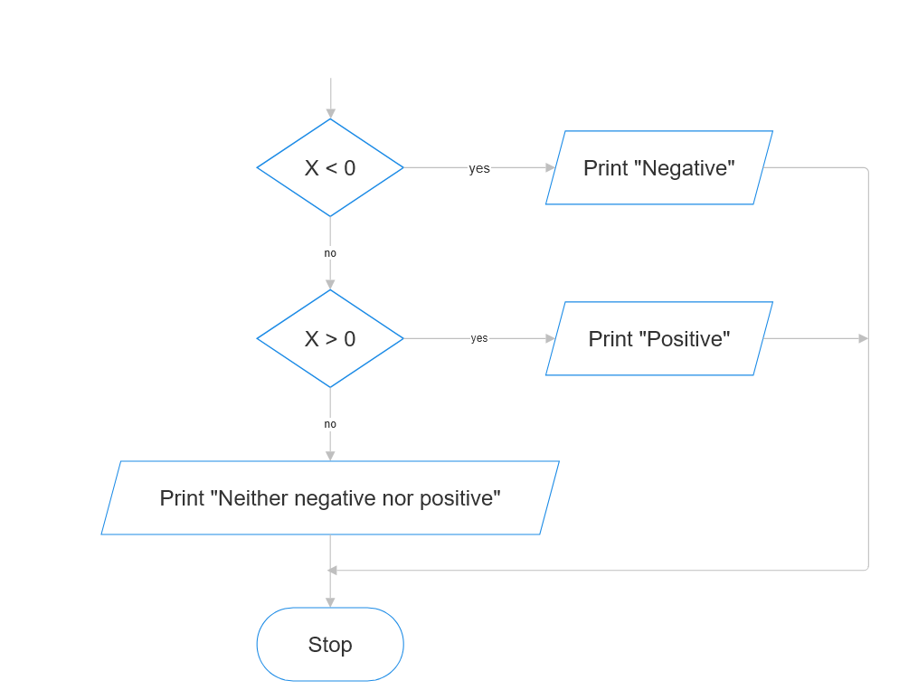
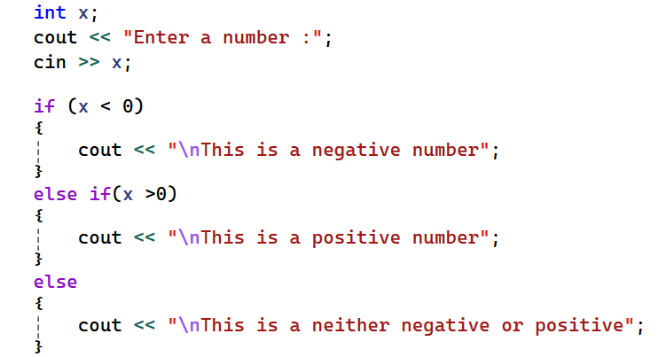
Making decision, If else if else

Slide 33
Relational operators
less than
<
greater than
>
less then or equal to
<=
greater than or equal to
>=
is equal to
==
is not equal to
!=

Slide 34
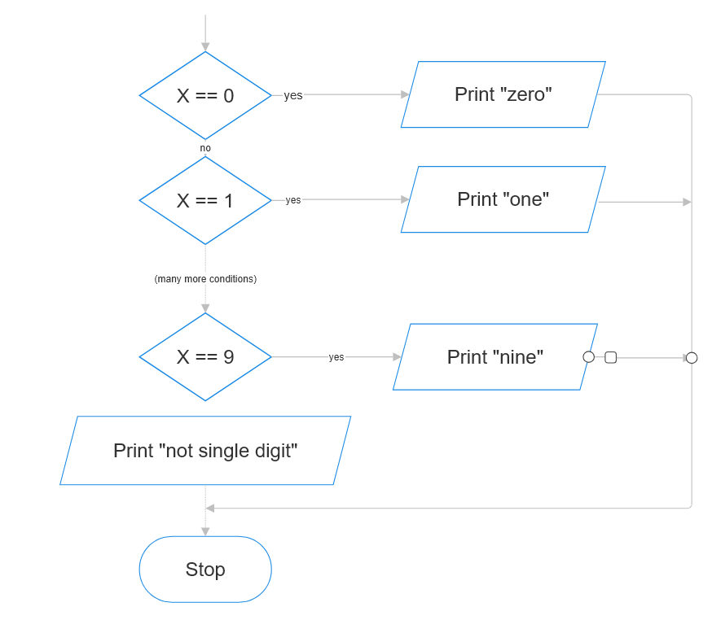
Lab (if else)
Get user to enter a single digit number
Print the digit in English
0 → “zero”
1 → “one”
…
8 → “eight”
9 → “nine”
(Anything else) “→ this is not a single digit number”

Slide 35
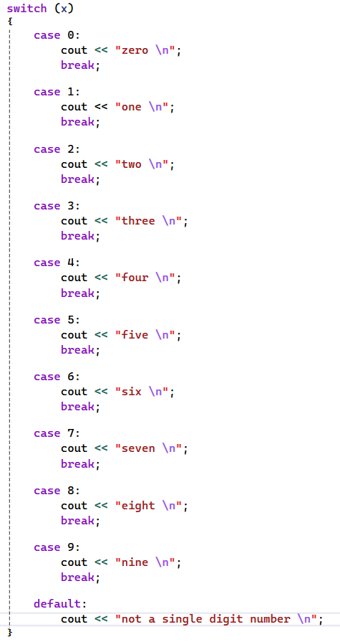
Branching using Switch

Slide 36
Lab (switch)
Get user to enter a single digit number from [1,2,3,4,5,6,7]
Convert it into day of week
1 → “Sunday”
2 → “Monday”
3→ “Tuesday”
4 → “Wednesday”
5 → “Thursday”
6 → “Friday”
7 → “Saturday”
(Anything else) → “Invalid number for a day”

Slide 37
Asssignment , quiz game
Create a quiz game containing atleast 3 questions.
Print a question ,
provide 4 numbered options ,
User enters the option number and verifies result.
Keep score of how many correct responses user input
Print the score (e.g.3 /4 correct , )
An example Q1. What is the capital of USA ?
1. Seattle
2. Los Angeles
3. Washington DC
4. Chicago
Enter your response : _

Slide 38
Boss Assignment Convert a string of 0,1 to decimal
Get a string of 0s and 1s from user
Calculate what the decimal number for it is ?
Note
This is very hard , may take hours/days/weeks
Hint
You would need to know
string (or char array)
Loops (while)
Binary logic
*Loops within loops

Slide 39
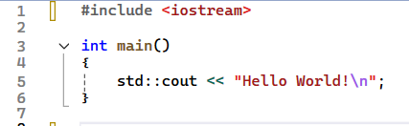
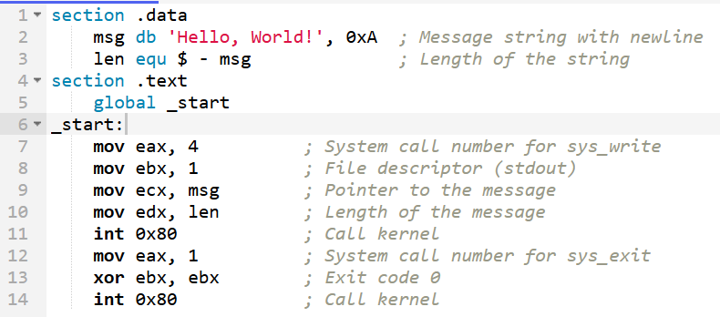
Code, as seen by computer : HelloWorld
Cpp vs assembly

Slide 40
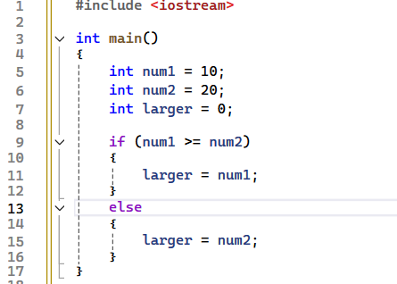
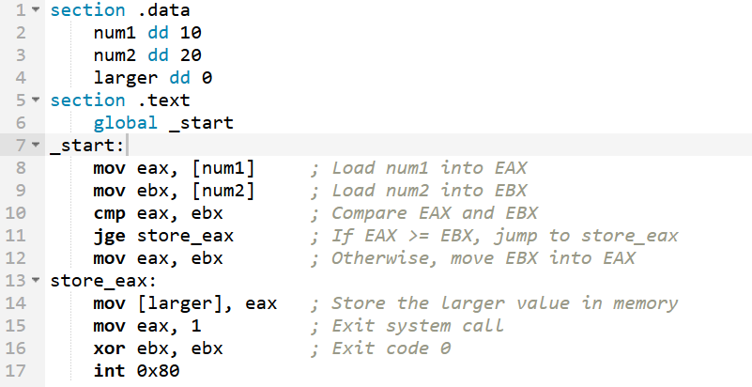
Code , as seen by computer : Find larger num.
Cpp vs Assembly

Slide 41
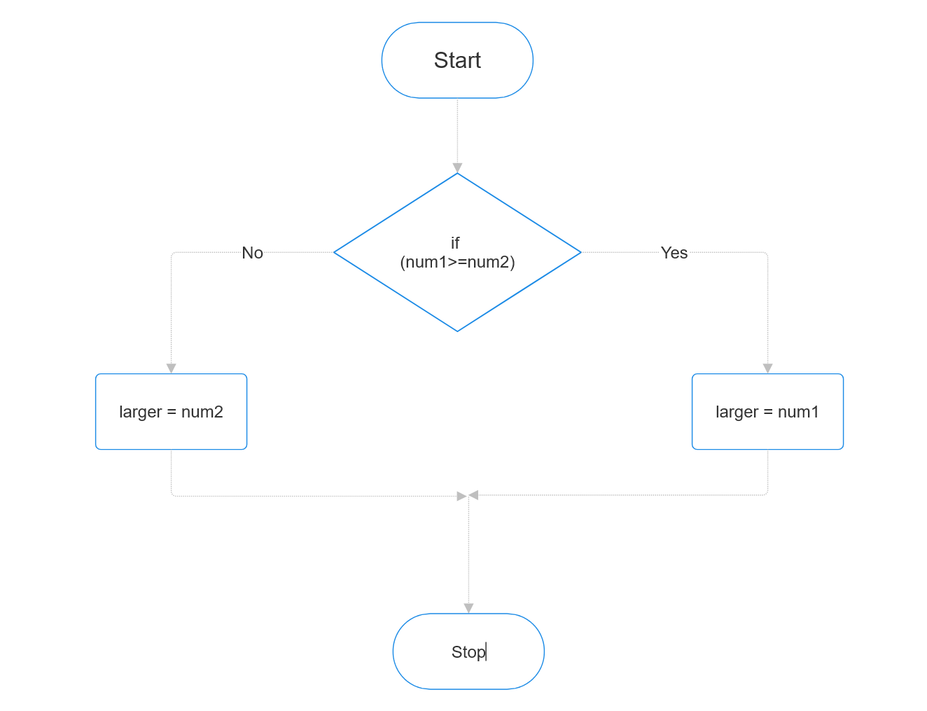
Branching visualized
Code looks sequential
But really has branches

Slide 42
Loops : Things that happen over and over …
Years
…,2024,2025, …
Seasons
Spring, summer, fall, winter
School
Learn , Homework, Tests
Scoring
Reading a book
Title,… page, page,page …,the end

Slide 43
Decision making and looping
Loops
Print “Hello”10 times
10 x cout ?
What if 100 times ?
100 x cout ??
Can we do better ?

Slide 44
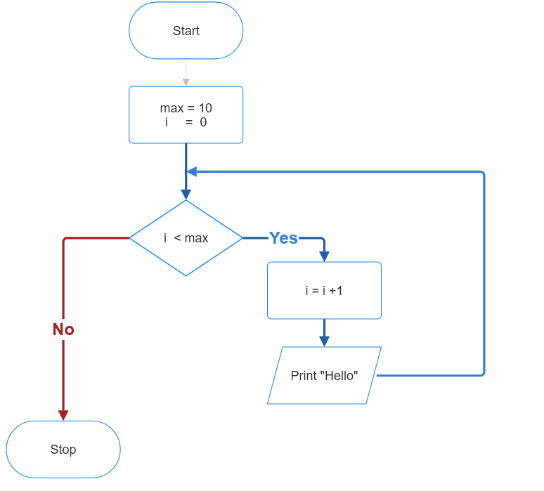
Loop : visualized
Print “Hello”10 times

Slide 45
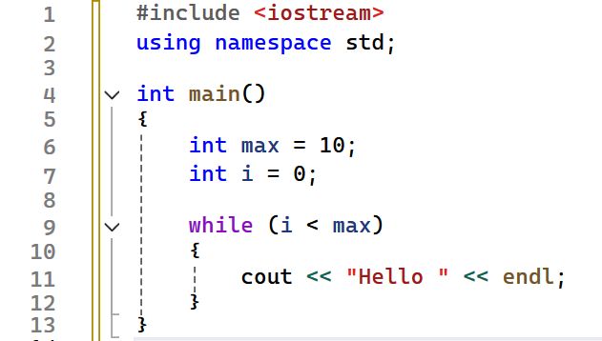
Loop : visualized
Print “Hello”10 times

Slide 46
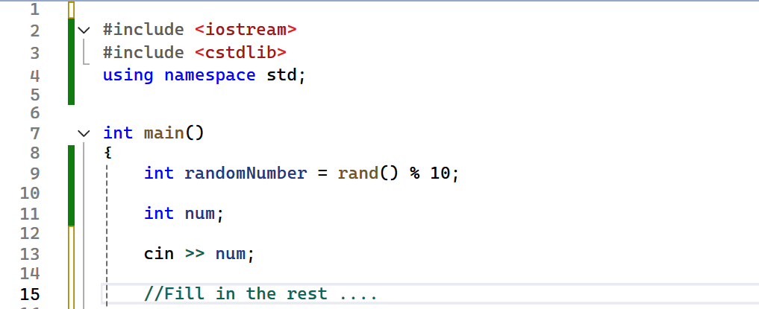
Assignment 1, Guess the number
Computer finds a random number between 0..9
User guesses it
If user fails .. they try again … (*use while loop)

Slide 47
Boss Assignment
Get a number from user
Convert the number(int) into binary.
Examples
0 → 0
1 → 1
7 → 111
8 →1000
12→1100
15 →1111

Slide 48
Assignment 2.* (hint : use while)
Print first 10 numbers
Print the sum of first N numbers
N is provided by the user
Find the sum of first N odd numbers
Find smallest number divisible by all numbers between 1 to 20.
Find the greatest common factor of 2 numbers .
2,4 → 2
6,9 → 3
EASYMEDIUMHARD

Slide 49
Decision Making at a glance
Branching
If/else
slides 30 - 32
switch
goto
Looping
while
slide 45
do/while
for
Jumps in loops
break
continue

Slide 50
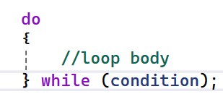
Do-while loop
Do-while is an exit controlled loop
( while is entry controlled)
When loop content should execute at least once
E.g
Looping until user enters valid value
Gather game input for game loop

Slide 51
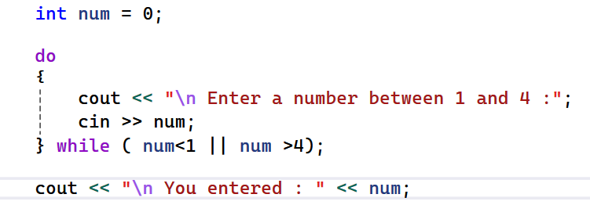
Do while : example
Get a number between 1 and 4 from user.
Ask again if the numbers is not in range
Print the number and stop if it is in range.

Slide 52
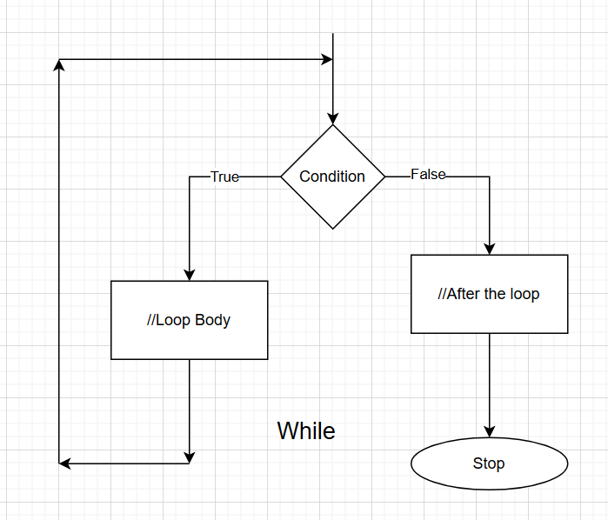
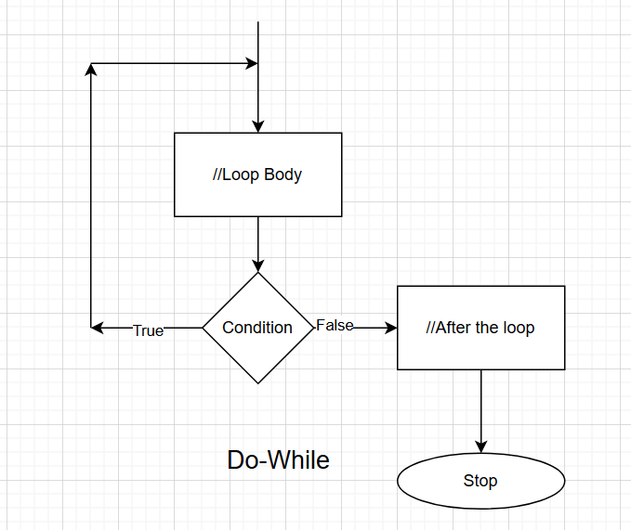
While vs do-while, visualized

Slide 53
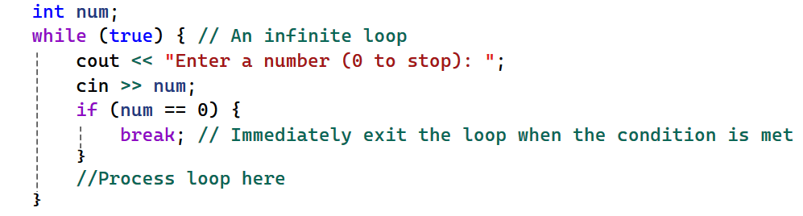
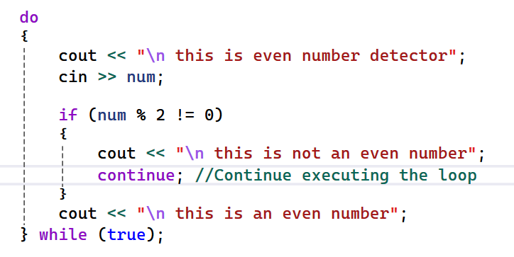
Jumps in loops
Break
Jump to after the end of loop
Loop does not execute
Continue
Jump to the beginning of the loop
Loop continues to execute

Slide 54
Assignment 1: Create a menu driven calculator
Enter 2 numbers
Get user option ( 0 to 5) repeatedly
1 → add the two numbers and print
2 → subtract 2nd from first number and print
3 → multiply the two numbers and print
4 →divide 2nd by first number and print
5 →do nothing , and restart
0 →stop the loop
Try using both loops and compare result
while
Do/while
Use break and continue

Slide 55
Boss Assignment: Menu driven multi purpose program
Create a multi purpose program running until user enters 0
Enter 2 numbers e.g. a, b;
Get user options repeatedly and perform the operation
1 → find the least common multiple of 2 numbers
2 → find the highest common factor of the 2 numbers
3 → find ‘a’ raised to the power of ‘b’ using loops : a^{b}
4 → find 1/a^{b} using loops
5 → do something random from between 1 and 4
#include<cstdlib >
int rand = 1+ rand()%4;
0 → Exit the program

Slide 56
Sequences
Game leaderboard
Scores per test
Temperature per hour of day
…

Slide 57
Sequence of data types : Arrays
int days[7];
Variables ‘days’
Memory locations : 7 x sizeof(int) = ?
1st : day[0];
7th : day [?]
float avg[12]
Variable ‘avg’
Memory locations : 12 x sizeof(int) = ?
1st : ?
12th : ?

Slide 58
Array syntax
int days[7];
one dimensional array
[ ] square backets require a constant value
Index starts from 0
Access nth value using days[n];
Initialization
Option 1
int days[7] = {1,2,3,4,5,6,7};
Option 2 : omit the size
int days[ ] = {1,2,3,4,5,6,7};
Or GIGO ??
* Array size is constant, cant change after creation.

Slide 59
Memory layout
int days[7] = {1,2,3,4,5,6,7};
Layout is Sequential
Next number is right after the previous … all the way to end
Caution
Do not go beyond the bound of array … that is GIGO
0 | 1 | 2 | 3 | 4 | 5 | 6
1 | 2 | 3 | 4 | 5 | 6 | 7

Slide 60
Lab
Q1:average of 5 numbers
Get 5 numbers from user
Print the average of the 5 numbers
Hints
cin>>num[i];
sum = sum + num[i];
loops
* Consider the right data type for average…
Q2 : search whether a number exists in above array
(After printing average In the above entered numbers )
Get user to enter a search num
Return at what index location it exists in the array.

Slide 61
Names are sequence of characters
char name[100];
Characters arrays are ‘null’ terminated
E.g name = “ChatGPT”;
if (name[7]== ‘\0’) would be true.
So if names are array of chars…
What is array of names ??

Slide 62
Double dimension arrays
int nums[5][3] ;
5 row of 3 integers each
5 x 3 = 15 total integers
char names[15][100];
15 names … max size of 100 each.
15 x 100 = 1500 characters
How to create 10 rows of 100 floats each ?
What is the total number of floats used ?
What is the total memory size.

Slide 63
Memory layout : double dimension
int nums[5][3] ;
2 dimension = 2d Matrix
Rows are horizontal
Columns are vertical
Total 5x3 = 5 cells
0 | 1 | 2
0
1
2
3
4

Slide 64
Assignment 1
Get 5 numbers from user
Print the highest number from the five.
E.g. user enters 5,6,2,3,7
Print
The highest number is : 7

Slide 65
Boss :Assignment
Get 5 numbers from user
Print all the numbers in sorted order
E.g. user enters 5,6,2,3,7
Print
2,3,5,6,7
Hint
* would need multiple loops
* may need to know how to SORT data
Sorts have not been taught ,do the best you can.

Slide 66
Reuse, organize, simplify code
How would you …
Reuse the functionality that you have already implemented ?
Simplify your code that you can work on it independently
Organize your code for easy readability / maintainability …
Best programming Tool
Functions
Best Principle
DRY → Don’t Repeat Yourself ( i.e. in code ☺)

Slide 67
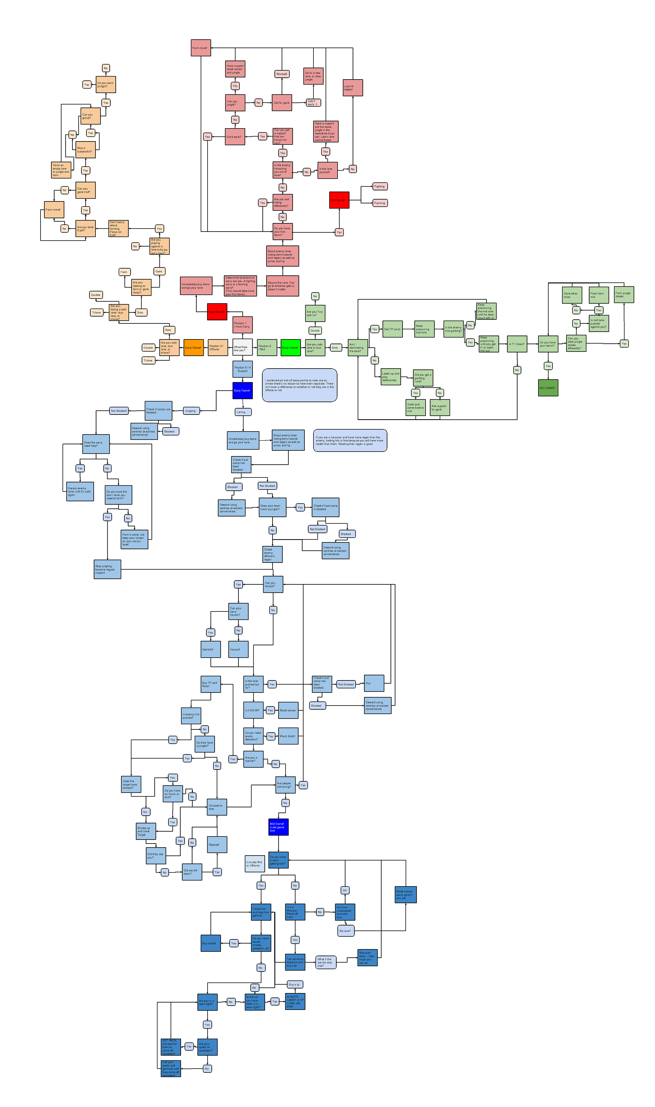
Functions : Need
How to do you make spaghetti ?
Write a big enough program
Who/what is most popular in C/C++
The main function
Nothing happens without the main …
Principle
Make spaghetti to eat but not in code.
Write a function , and it will be popular.

Slide 68
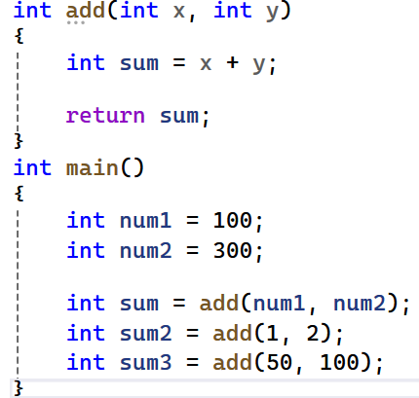
Functions : How ?
Write a function
Once
Use a function
Many times

Slide 69
Lab : lets revisit calculator
Create a calculator
Take 2 numbers from user ( x, y)
Take options 1 to 4 from user
Based on option print the following (use functions)
1→ x+y;
2→ x-y;
3→ x*y;
4→x/y
5 → exit the program
(option <1 || option >5 ) → “chose between 1 to 4”

Slide 70
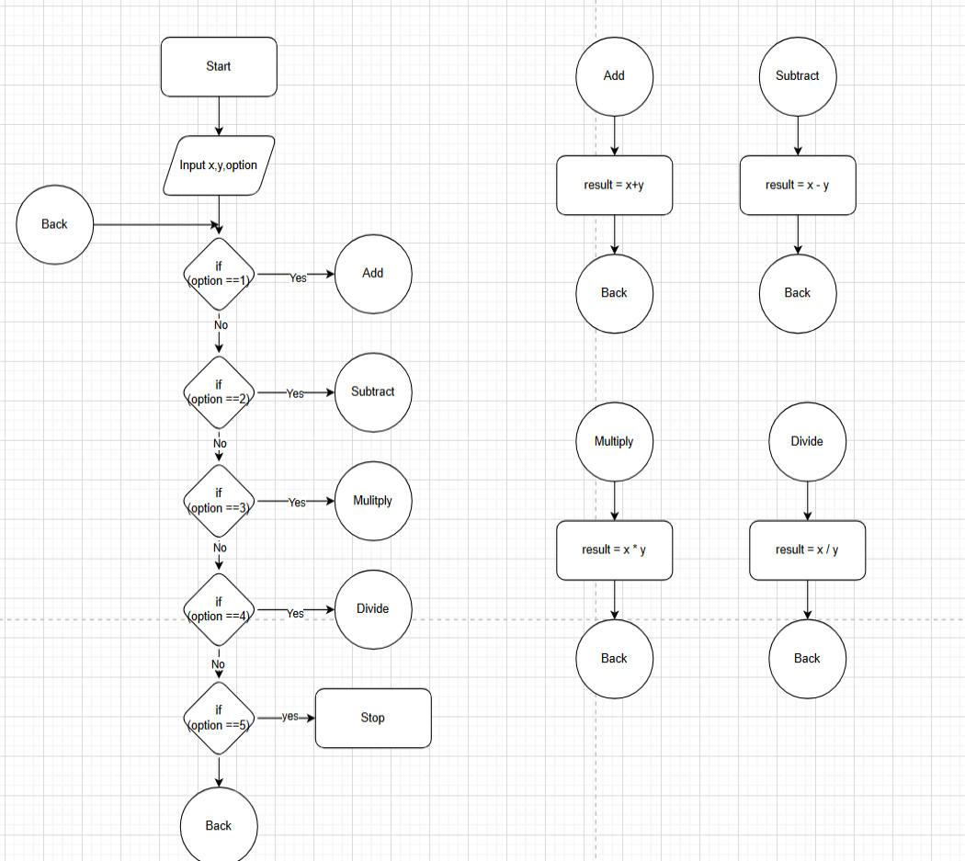
Flowchart View
Function ~ Circle
Return ~ Back Circle
Lets code this …

Slide 71
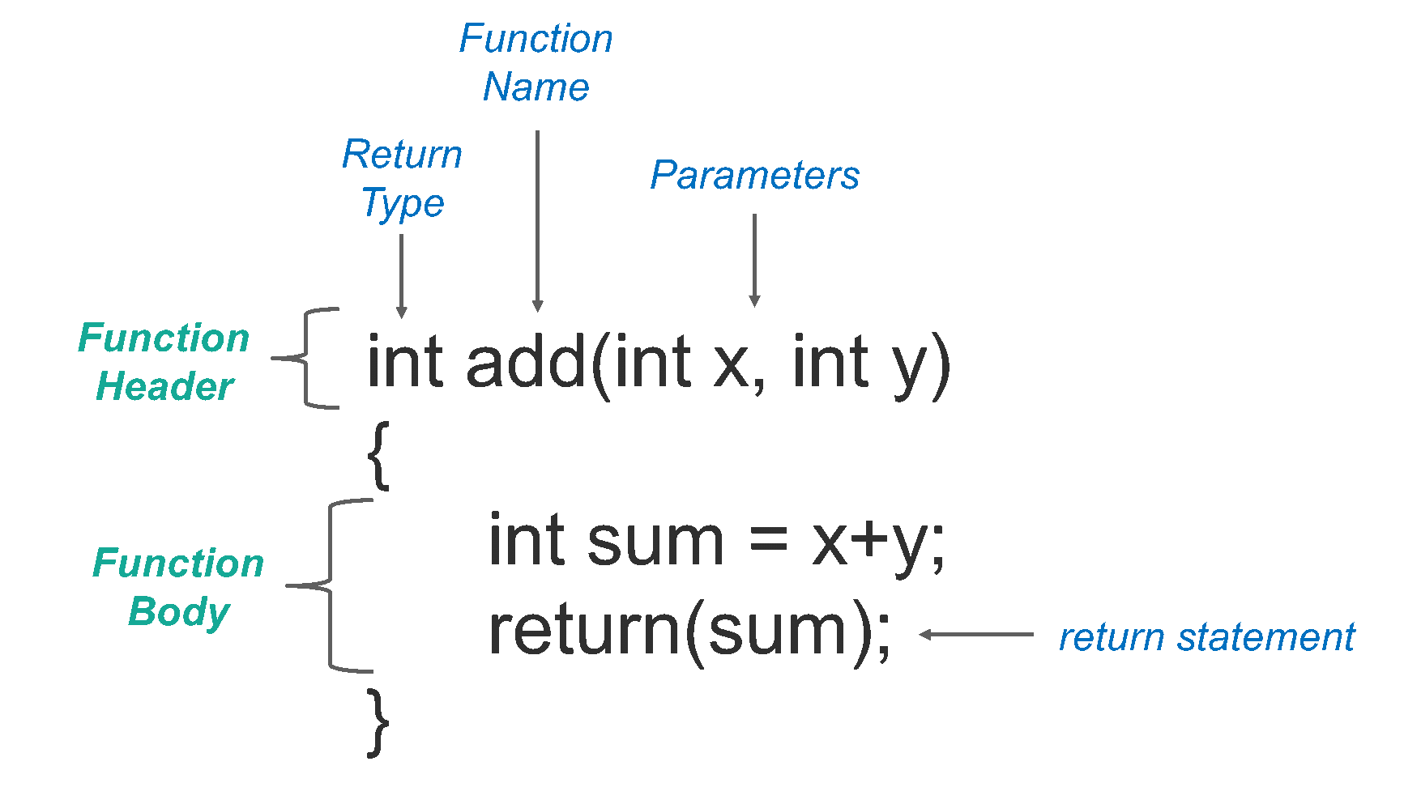
Anatomy of a function

Slide 72
More function nuances
Function don’t have to return a value
Then must use “void” as return type.
void Print(int x) {..}
Function can exist without parameters
void Print(){..}
Functions can call other functions (nested functions)
Like main calls add
A function can call itself (recursion)

Slide 73
Assignment
Write a program to convert temperaturs
Celsius to Fahrenheit
and Fahrenheit to Celsius
Use enters temperature and option
Option 1
Assume Celsius, Convert to Fahrenheit
e.g. 0 → 32
Option 2
Assume Fahrenheit, Convert to Celsius
e.g. 180 →100
Formula
F = C * (180/100) + 32
C = (F -32) * 100/180
Must use functions

Slide 74
Boss Assignment
Fibonacci series : 0,1,1,2,3,5,8,13,21,34,55….
Starts with 0,1 and each number after is sum of previous 2 numbers
0 + 1 → 1
1 + 1 → 2
8+13→21
Task 1
Print n^{th} number from Fibonacci series using functions
Task 2
Print each Fibonacci number all the way to n^{th} number
Hints
Use functions
Use appropriate function parameters
Use recursive functions

Slide 75
Strings in C++
String are made of characters
Fundamentally it is array of char
char name[10];
They are null terminated
Last character in array is null : ‘\0’
Example
char greeting[20] = “hello;
char name[20] = “Adam”;
* there is a second advanced type of string in C++, std::string
This is fundamentally different from array of char above
(But it is also very similar)

Slide 76
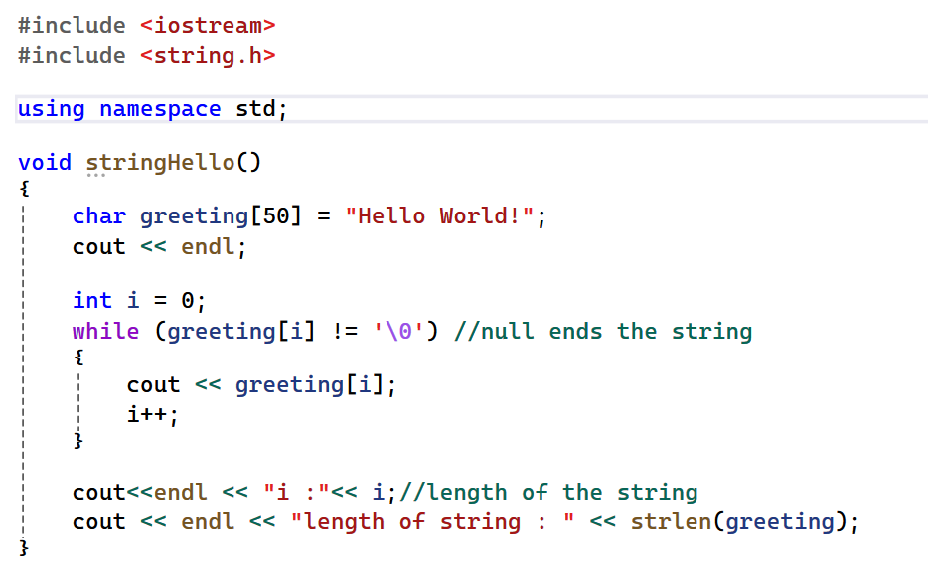
String : fundamentals

Slide 77
String operations : include<string.h>
strlen(): Returns the length of a string (excluding the null terminator).
strcpy(): Copies one string to another.
strcat(): Concatenates two strings.
strcmp(): Compares two strings.
strstr(): Finds the first occurrence of a substring within a string.
Some compiler will require to use _s versions of these functions
E.g. strcpy_s instead of strcpy

Slide 78
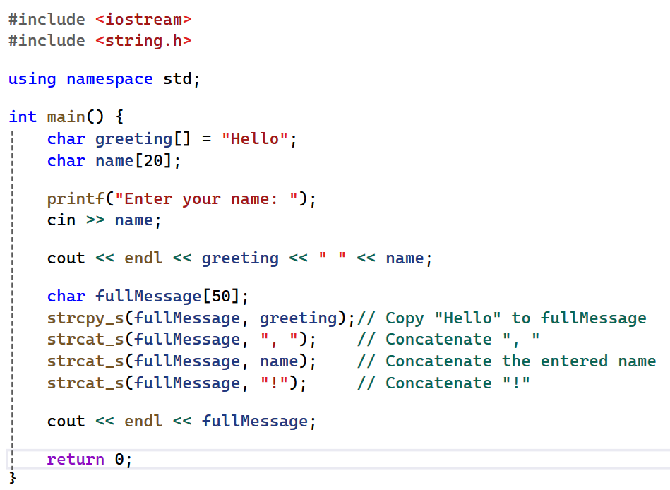
Using string functions

Slide 79
String operations
How do you find string sizes ?
strlen
How do you compare strings ?
For <,>,==
*Use strcmp

Slide 80
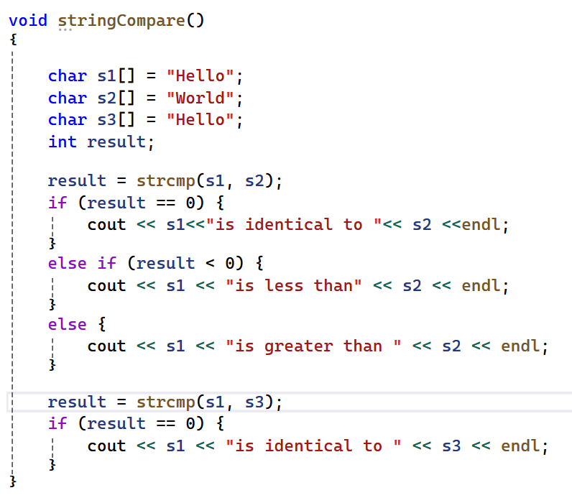
Strcmp example

Slide 81
Assignment
Convert string to upper cases
hello ->HELLO
ChatGPT -> CHATGPT
Reverse a string
Hello -> olleH
six-seven -> neves-xis

Slide 82
Boss Assignment
Count words in a sentence
“A quick brown fox jumps over the lazy dog” -> 9
“Pa may we all go to” -> 6
Reverse the words of the sentence in place
“A quick brown fox jumps over the lazy dog”
“A kciuq nworb xof spmuj revo eht yzal god”
“Pa may we all to go”
aP yam ew lla ot og”

Slide 83
Back to Data types
Fundamental data type
int, char, float, bool, …
And arrays
Custom data types
struct
Short for structure
class

Slide 84
struct : use case
Need for grouping multiple different types
Helps organize complex data in a meaningful way
Examples ….
time : seconds, minutes, hours
date : day, month, year
book : author, title, price, year
player : username, experience
game leaderboard : player, rank, score

Slide 85
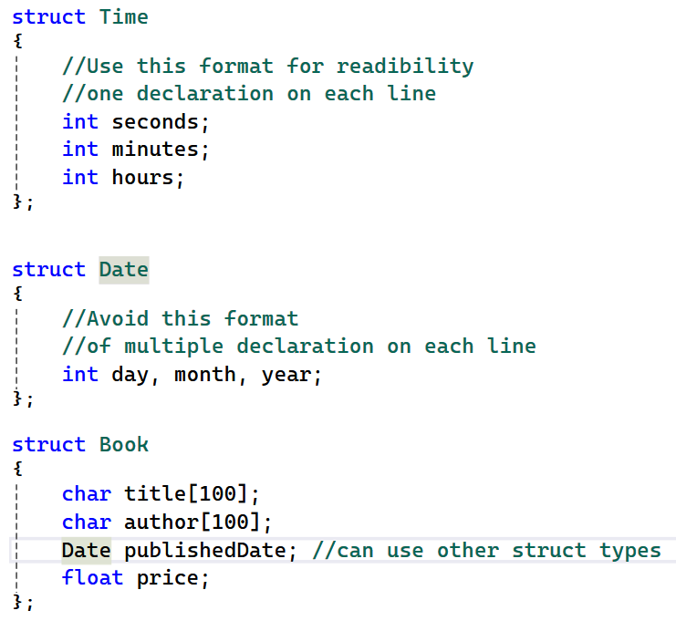
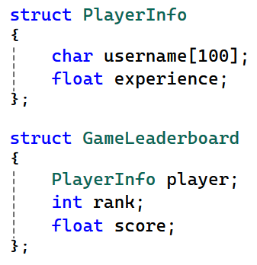
struct : definition

Slide 86
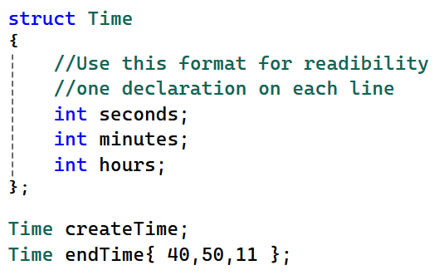
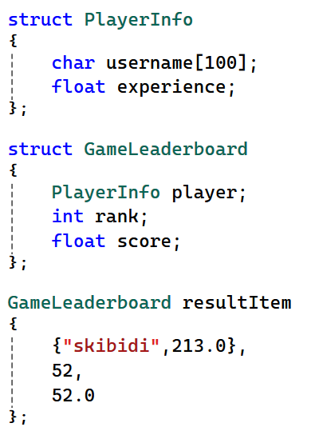
struct : variable declaration

Slide 87
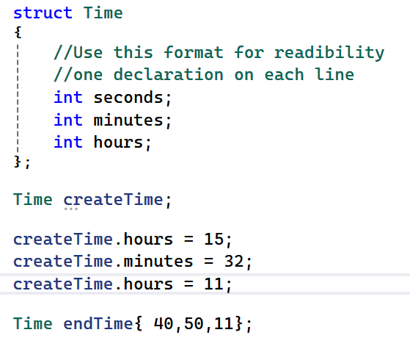
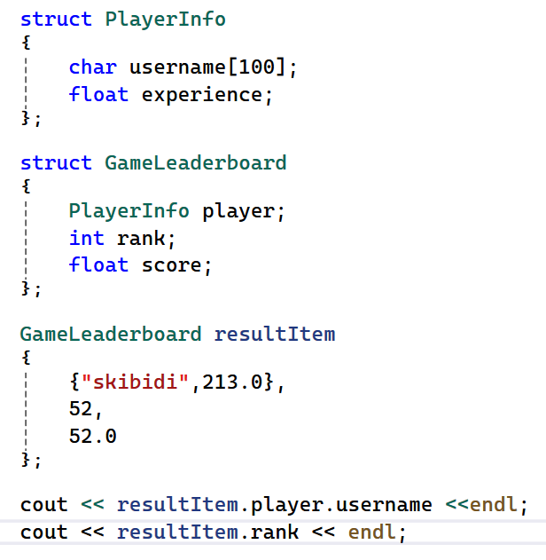
Structure : member access using . operator

Slide 88
Assingment
Create a function to take a struct of PlayerInfo and print it.
Create a function to
take 2 Time variables as parameters
Add them
And return the new Time
Hint
Time AddTime(Time timeA, Time time B) { //fill in here
}

Slide 89
string data type
We already know few built in types
int , float , char, bool
string
Is a derived data type,
Useful for names, description etc.
Header
#include<string>
Usage
string name;
cin >> name;
cout <<name;

